Slide 1
An Optimal Control Approach to Robust Control of Robot Manipulator
Yashveer Jain (119252864)
Mayank Sharma (119203859)
University of Maryland, College Park
Nov 23, 2022

Slide 2
Overview
Unknown load placed on a manipulator and the other uncertainties in the manipulator dynamics.
Designing a robust control law that will guarantee the performance of the manipulator under these uncertainties.
Translating the robust control problem into an optimal control problem.
Using the optimal control approach to solve the robust control problem.
Solving the optimal control problem is much easier to do in many cases.

Slide 3
Introduction
Uncertainties related to manipulator:
Weight of the Object is unknown because the object itself is not known before-hand.
The friction and other parameters in the manipulator dynamics may be uncertain because it is difficult to model and measure the them precisely.
Main Objective of Optimal Control is to determine the control signal, that
Minimise a cost
Maximises a chosen performance index
The plant states satisfy some physical constraints.
LQR has been used to solved the Optimal Control problem.

Slide 4
Manipulator Dynamics
The dynamics of the Robot Manipulator
Assumption for the following bounds on the uncertainties:
The State Space equation, including uncertainties (h(X) and f(x)):
where,

Slide 5
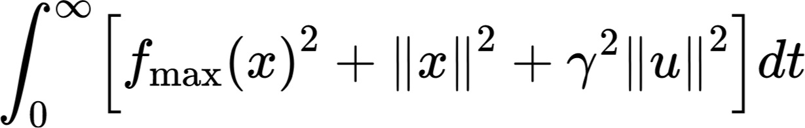
Optimal Control Approach
Consider the following nonlinear system:
Robust Control Problem: Find a feedback control law such that the closed loop system is globally asymptotically stable for all uncertainties ƒ(x) satisfying the condition that there exists a nonnegative function ƒ_max(x) such that ||ƒ(x)|| ≤ ƒ_max(x).
Optimal control Problem :For the auxiliary system x_dot = Ax + Bu find a feedback control law u=u0(x) that minimizes the following cost functional:

Slide 6
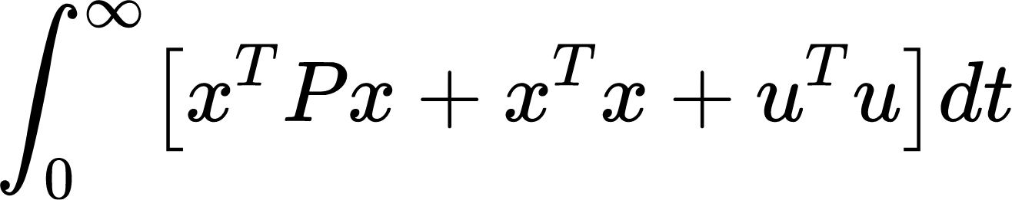
Optimal Control Problem : for linear system, find a feedback control law function that minimizes the cost :
The relation between the robust control problem and the optimal control problem is shown in the following theorem :
Theorem : If the solution to the optimal control problem exists, then it is a solution to the robust control problem.

Slide 7
Given Manipulator state space equation:
Controller will stabilise the system to joint angles to `0` from any given joint angles. And so cost function is designed taking this into consideration.
After solving the following LQR problem,using Riccati equation. We get, optimal control input u0 (x) =
Derivation is on next page:

Slide 8
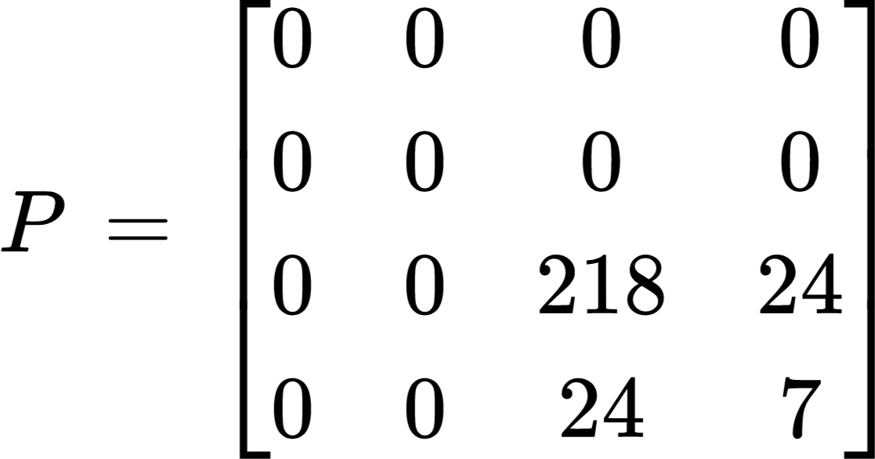
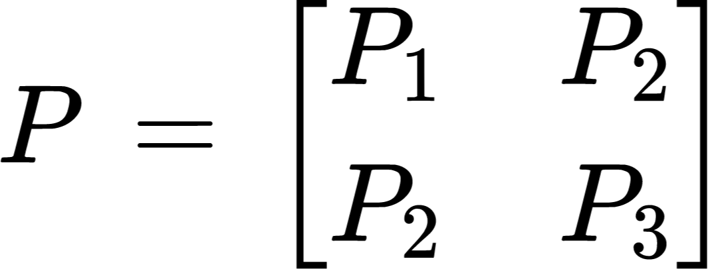
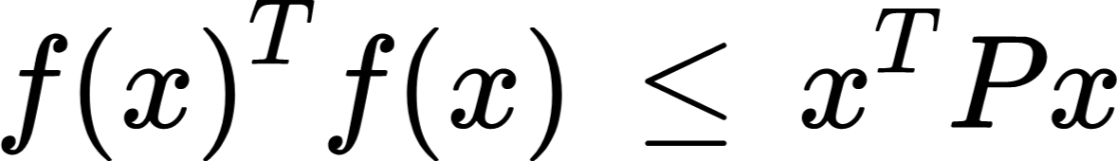
From Optimal control input equation :
where,
And P is given by largest physically feasible region of x and we assume a quadratic bound for f(x)Tf(x) :
Since x1 and x2 take values only in the interval [-pi,pi] and x3 and x4 are bounded by the limit on the speed of the robot manipulator.

Slide 9
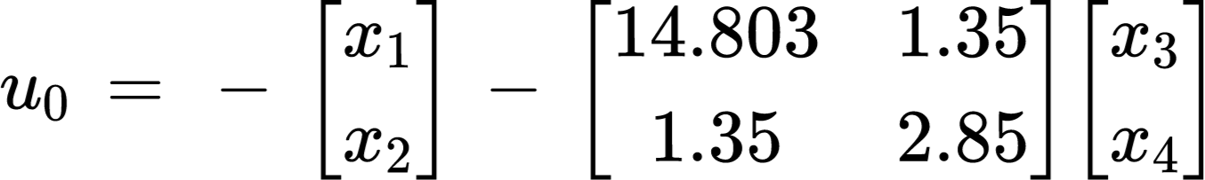
Implementation
Controller will stabilise the system to joint angles to 0 from q1 = 60 deg and q2 = 30 deg.
Code using Python :
A = [0 I; 0 0] \in R4x4
B = [0 ; I] \in R2x4
X = (x1,x2,x3,x4) = (q1,q2,q1_dot,q2_dot)T
Robot Manipulator parameters is defined as per paper, such as mass, inertia, and friction coefficients for each link, of scara 2DOF manipulator.
optimal control input:

Slide 10
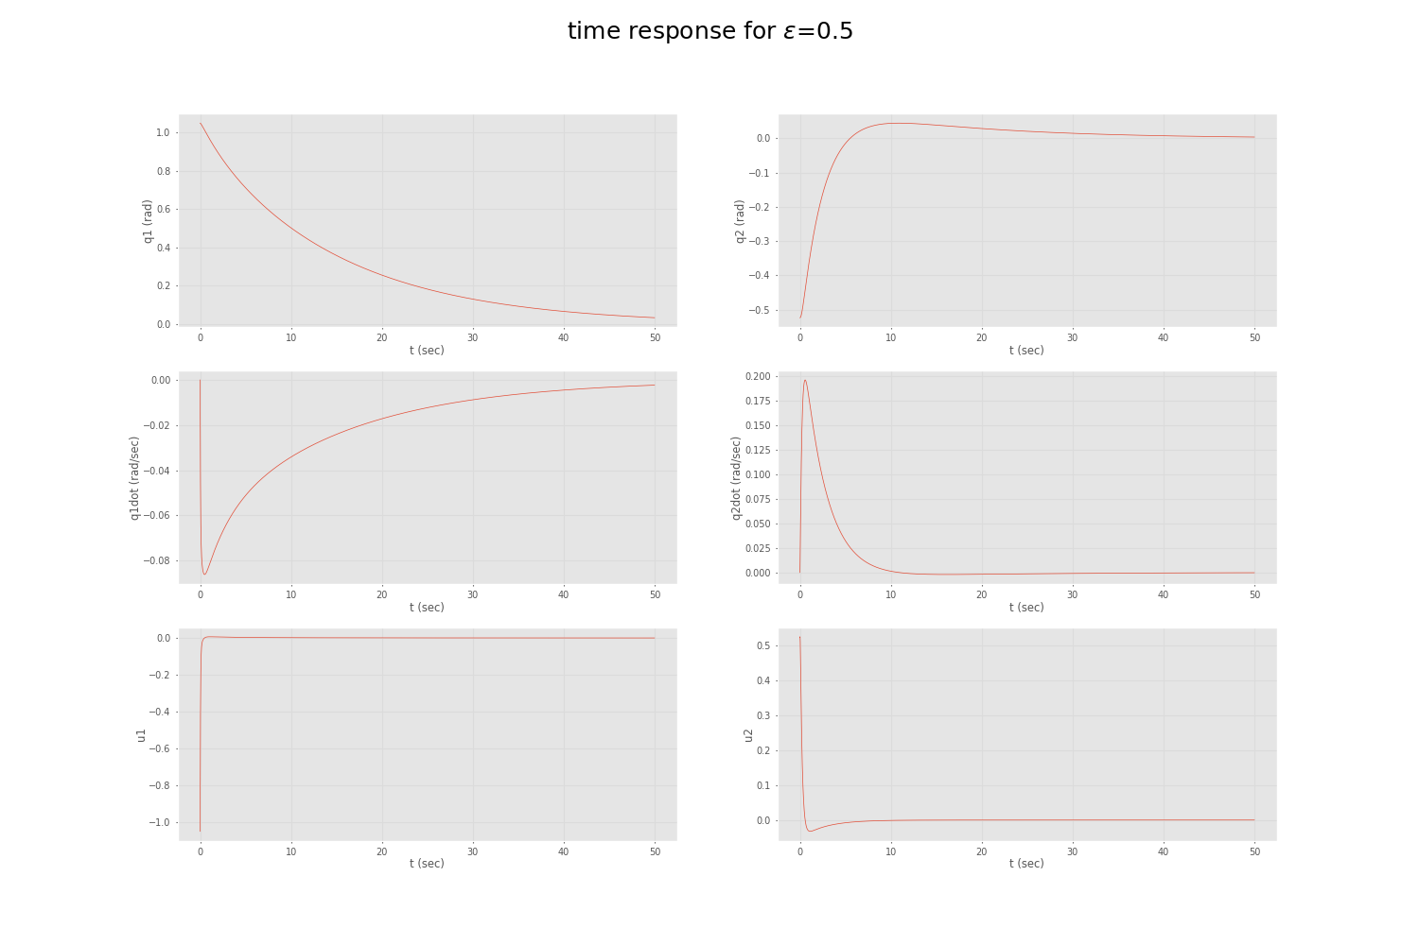
Simulation Result for ε=0.5: Plot

Slide 11
Simulation Result for ε=0.5 : Animation
Initial states are :
q1 = 60 deg
q2 = -30 deg
Desired states are:
q1 = 0 deg
q2 = 0 deg
Here, time and number of steps has been reduced from 100 sec to 10 sec for faster visualization.

Slide 12
Reference
Ours Implementation :
https://github.com/yashveerjain/Optimal-Control-Robot-manipulator.git
Feng Lin and R. D. Brandt, "An optimal control approach to robust control of robot manipulators," in IEEE Transactions on Robotics and Automation, vol. 14, no. 1, pp. 69-77, Feb. 1998, doi: 10.1109/70.660845.

Slide 13
Thank You

